Slide 1

Department of Computer Science and Engineering
Integrating Machine Learning Algorithms With Quantum Annealing Solvers For Online Fraud Detection
PRESENTED BY
Soma Sekhar Goud Karpurapu (20471A0526)
Sunil Pulivarathi (20471A0547)
Kruparao Damavarapu (20471A0512)
Under the Guidance of,
M.SATHYAM REDDY _{M.Tech},
Assistant Professor,
Department of Computer Science and Engineering,
Narasaraopeta Engineering College (Autonomous),
Narasaraopet- 522 601
Review No.1 Batch No.AB4 Department of CSE

Slide 2
OUTLINE
Abstract
Introduction
Literature Survey
Research Gaps
Problem Statement
Objectives
Block Diagram / Flow Diagram
Methodology
Implementation
Conclusion & Future Scope
References
Question and Answers
Acknowledgements
Review No.1 Batch No.AB4 Department of CSE

Slide 3
ABSTRACT
Machine learning has been increasingly applied in identification of fraudulent transactions. However, most application systems detect duplicitous activities after they have already occurred, not at or near real time. Since spurious transactions are far fewer than the normal ones, the highly imbalanced data makes fraud detection very challenging and calls for ways to address it beyond the traditional machine learning approach. This study has proposed a detection framework, and implemented it using quantum machine learning (QML) approach by applying Support Vector Machine (SVM) enhanced with quantum annealing solvers. In addition to expense write-offs to cover shipping, refund, and other managerial expenses, businesses also lose sale opportunities from trusted customers and reputational risk.
Review No.1 Batch No.AB4 Department of CSE

Slide 4
INTRODUCTION
Fraudulent transactions cost businesses a significant amount of money each year. In the US, businesses lose an average of $4 billion annually due to fraudulent transactions, while insurance companies in the UK face losses of around £1.6 billion from fraudulent transaction claims. These losses not only include expenses for refunds, shipping, and other management costs but also result in missed sales opportunities from trustworthy customers and damage to the company's reputation. The introduction of the Credit card fraud detection using machine learning
Review No.1 Batch No.AB4 Department of CSE

Slide 5
Secondly, in spite of the need for real time or near real time fraud detection for online e-commerce transactions, the effectiveness of many existing systems is compromised since most detect only after the fraud activities have happened the loss has already occurred.
Thirdly, since the majority of the transactions are normal and fraudulent ones are rare, the datasets are highly imbalanced with the anomalous transactions treated as outliers.
Review No.1 Batch No.AB4 Department of CSE

Slide 6
LITERATURE SURVEY
No | Title | Author | Journal Name & Year | Methodology Adapted | Key Findings | Gaps
1 | Credit Card Fraud Detection Using AdaBoost and Majority Voting | Kuldeep Randhawa, Chu Kiong Loo. | https://ieeexplore.ieee.org/document/8292883 2018 | Fuzzy Query, 2+ data mining tool | Accuracy: 0.813 | Data Privacy and Confidentiality Issues
2 | Leveraging product Characteristics for online detection | Suyuan Luo, Shaohua wan | https://ieeexplore.ieee.org/document/8611468 2019 | SNA, K-Core and Coreness | Accuracy: 0.866 | Lack of Explanation for Conceptual Framework:
3 | A Fraud Detection Method for Low Frequency Transaction | Zhaohui Zhang, Ligong Chen, Qiuwen Liu | https://ieeexplore.ieee.org/document/8977544 2020 | Convolutional Neural Network(CNN). (LSTM). | Accuracy: 0.902 | Data Imbalance
4 | Credit Card Detection using state-of-the-art ML and DL | Iqra Malik, Naif Almusallam | https://ieeexplore.ieee.org/document/9755930 2022 | GBDT based, SVM,ANN | Accuracy: 0.984 | Imbalanced Dataset
Review No.1 Batch No.AB4 Department of CSE

Slide 7
LITERATURE SURVEY
Survey explores every methodology implemented among mentioned Literatures
It is observed that this approaches are given to Fact Checking and Sentiment Analysis.
The Problem of Fraud detection is classification oriented specifically binary classification, so many machine learning algorithms such as Artificial Neural Networks, LSTM, Supported Vector Machine (SVM) are utilized more often.
However in following survey it can be noted these algorithms are not very lenient on varying data and hence do not seems to provide required accuracy.
New methods such as Deep Learning and Natural language processing are explored to provide solution.
Review No.1 Batch No.AB4 Department of CSE

Slide 8
RESEARCH GAPS
In existing system used Fuzzy Query, 2+ data mining tool.
It is useful to work on small data sets only.
It does not provide more accuracy
In proposed system we used ANN and RF to work on large datasets and provide more accuracy than existing system
Review No.1 Batch No.AB4 Department of CSE

Slide 9
PROBLEM STATEMENT
The large use of Social media networking provided fast spread of wrong data.
It is difficult to determine all of the messages or posts on social media to stop
Some information can lead to make the wrong things because of the social media and the present technology also easy to handel.
It will effect the perception of human
Review No.1 Batch No.AB4 Department of CSE

Slide 10
OBJECTIVES
Real-time Monitoring: Detect and respond to fraudulent activities in real-time.
Transaction Anomaly Detection: Identify unusual patterns or deviations from normal transaction behavior.
Machine Learning Models: Utilize machine learning algorithms to predict and identify fraud patterns.
Review No.1 Batch No.AB4 Department of CSE

Slide 11
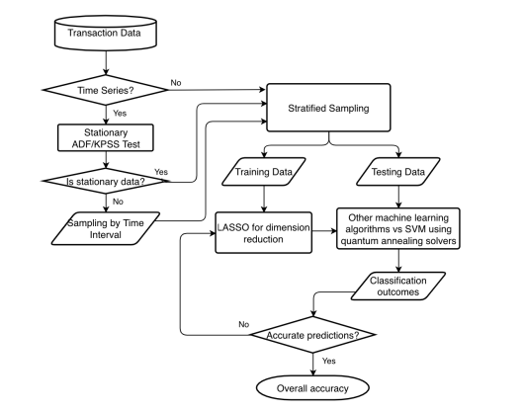
BLOCK DIAGRAM OR FLOW DIAGRAM
Review No.1 Batch No.AB4 Department of CSE

Slide 12
METHODOLOGY
A dataset containing the large amount of data sets, obtained from Kaggle.
The data was cleaned and pre-processed to make it suitable for analysis, including tasks like removing punctuation, tokenization, eliminating stop words, stemming.
Feature extraction was performed using the SNA-K core to calculating term frequency.
ANN and some classifiers used to train the data.
The system was implemented using Python programming language in Google Colab, with a front-end developed using HTML, CSS, and JavaScript.
Online fraud detection, was used to develop the web application for identifying the fraud and the solving process to secure the online platform.
Review No.1 Batch No.AB4 Department of CSE

Slide 13
IMPLEMENTATION
Software Specifications:
Browser: Chrome
Operating System: Windows 11
Python (Visual Studio Code)
Flask
Hardware Specifications:
Processor: AMD Ryzen 5 5625U with Radeon Graphics@2.30 GHz
Hard Disk: 1TB
RAM: 8GB
Review No.1 Batch No.AB4 Department of CSE

Slide 14
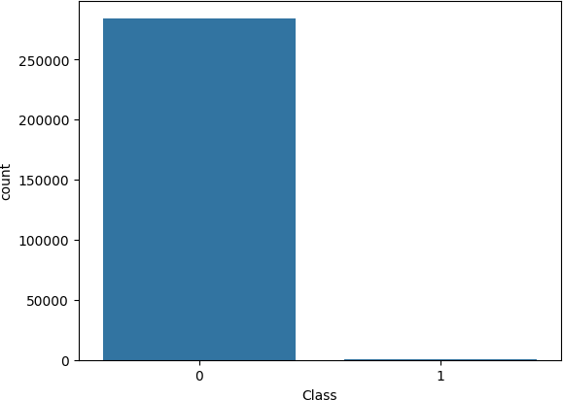
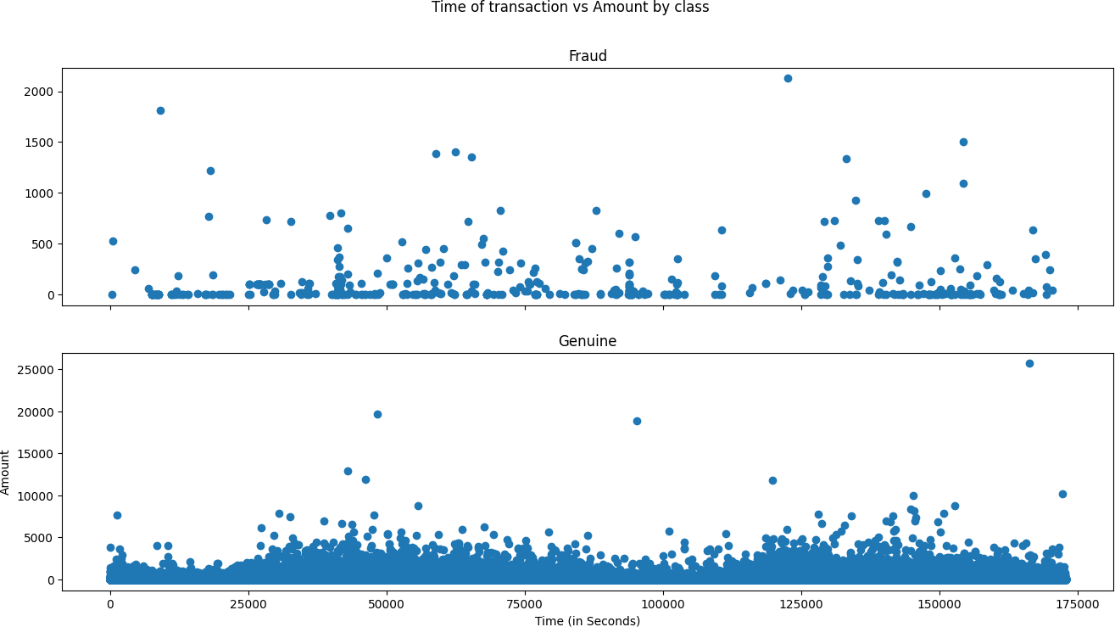
Fig: 1 Genuine Values in Dataset
Fig : 2 Approximate costing of online orders
Review No.1 Batch No.AB4 Department of CSE

Slide 15
CONCLUSION and FUTURE SCOPE
QML has gotten a developing measure of consideration for its capability to resolve significant issues because of its computational capacities. To legitimize the speculation for potential execution gains, it is fundamental to recognize the main regions for QML application because of the challenges and cost of changing over issues into the QUBO design [21] expected for quantum processing.
Fast and proficient misrepresentation identification is an incredible choice for QML arrangements because of the predominance of e-business, online exchanges, and the critical misfortunes brought about by fake exercises.
Review No.1 Batch No.AB4 Department of CSE

Slide 16
REFERENCES
[1] S P, Maniraj& Saini, Aditya & Ahmed, Shadab & Sarkar, Swarna, “Credit Card Fraud Detection using Machine Learning and Data Science”, International Journal of Engineering Research 2021 and. 08. 10.17577/IJERTV8IS090031
[2] https://www.kaggle.com/datasets/mlg-ulb/creditcardfraud
[3] D.Varmedja, M. Karanovic, S. Sladojevic, M. Arsenovic and A. Anderla, "Credit Card Fraud Detection - Machine Learning methods
[4] L. Columbus. (2020). How E-Commerce’s Explosive Growth is Attracting Fraud. [Online].
[5] LexisNexis. (2020). Lexis/Nexis Solutions for 2020 True Cost of Fraud Study: ECommerce/Retail Edition.[Online]
[6] Salles, K. Belloze, F. Porto, P. H. Gonzalez, and E. Ogasawara, vol. 164, pp. 274–291, Jan. 2019.
Review No.1 Batch No.AB4 Department of CSE

Slide 17
[7] F. Itoo, Meenakshi, and S. Singh, ‘‘Comparison and analysis of logistic regression, Naïve Bayes and KNN machine learning algorithms for credit card fraud detection,’’ Int. J. Inf. Technol., vol. 13, pp. 1503–1511, Feb. 2021
[8] N. Rtayli and N. Enneya, ‘‘Enhanced credit card fraud detection based on SVM-recursive feature elimination and hyper-parameters optimization,’’
J. Inf. Secur. Appl., vol. 55, Dec. 2020, Art. no. 102596.
[9] P. Hájek and R. Henriques, ‘‘Mining corporate annual reports for intelligent detection of financial statement fraud—A comparative study of machine learning methods,’’ Knowl.-Based Syst., vol. 128, pp. 139–152, Jul. 2017.
[10] S.Dhankhad, E. Mohammed and B. Far, "Supervised Machine Learning Algorithms for Credit Card Fraudulent Transaction Detection: A Comparative Study," 2018 IEEE International Conference on Information Reuse and Integration (IRI), Salt Lake City, UT, 2018, pp. 122-125
Review No.1 Batch No.AB4 Department of CSE

Slide 18

Review No.1 Batch No.AB4 Department of CSE

